Slide 1

Report for BFX-AT100 - Dec 2022 Mass Production Inspection
FOXCONN CPEG JBD_VN
Jan 03, 2023

Slide 2
Establish the Team
Team Leader
Team Member
PE: Michael, Nam
ME: Cheng Lun, Hugo
PM: An Tran, Yuri
PD: Wen Yong
QA: Ken, Robert
TE: Mark, Jones
IE: Hai Ly, Qiu-Heng
Foxconn
  MFG Manager : David Yin
  QA Manager : Toney Tu/ CB Lin

Slide 3
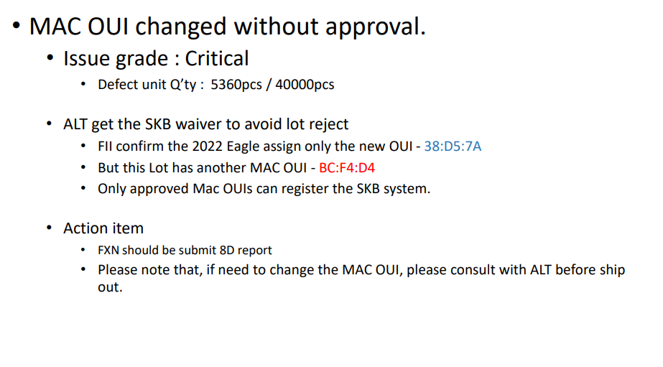
Description of Problems
Issue Description
On Dec 27, 2022 ALT customer feedback about Mass Production Inspection for shipment lots in Dec-2022 Detail as below:

Slide 4
Failure Analysis Report
2. Mac OUI changed
2.1 Root cause
On 28/11/2022, our factory have assigned new OUI for Eagle (New OUI : BCF4D4), but not to consult this problem with ALT. Affect 5360pcs/40000pcs need waiver to using by ALT.
2.2 Actions
Factory need confirm with ALT if have any change about products.
From Nov/E 2022 Eagle assign only the new OUI : BCF4D4 , add MAC OUI information when send a shipping file
Notify to ALT before apply new OUI for products.

